Slide 1


SHRI VISHNU ENGINEERING COLLEGE FOR WOMEN AUTONOMOUS::BHIMAVARAM
WEB SHELL DETECTION
BATCH:10
PRESENTED BY :
22B01A4627
22B01A4629
22B01A4637
22B01A4648
23B05A4606
PROJECT GUIDE:
Dr. V V R Maheswara Rao
Professor,CSE
reallygreatsite.com

Slide 2
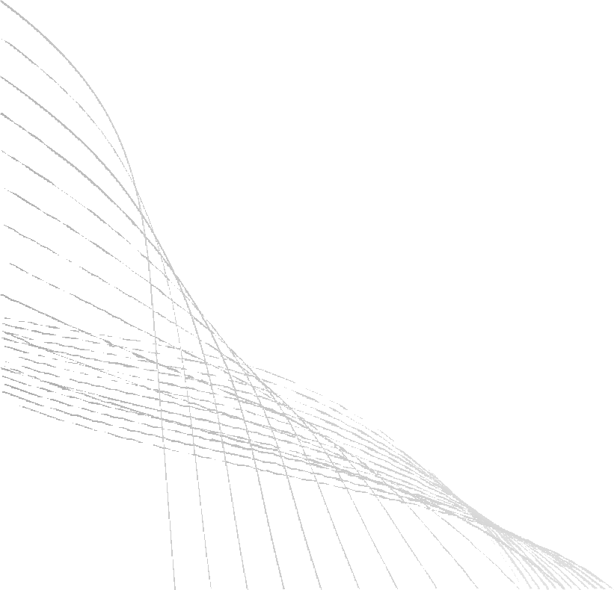
TABLE OF CONTENTS
ABSTRACT
INTRODUCTION
DESIGNS
FLOWCHART
IMPLEMENTATION SCREENS
REFERENCES
CONCLUSION

Slide 3
ABSTRACT
This project is designed to detect malicious web shells uploaded to web servers. It scans files for dangerous code patterns using signature-based detection. The project also uses the VirusTotal API to check files against known threats online. All results are shown on a simple web dashboard, helping users identify and remove harmful files quickly. This system helps protect websites from remote attacks in an easy and efficient way.

Slide 4
INTRODUCTION
Web shells are dangerous scripts that allow attackers to remotely access and control a server. They are commonly uploaded through file upload vulnerabilities in web applications. Once installed, they can steal data, install malware, or take down the server. Detecting web shells is challenging as they often appear like normal files. This project introduces a simple, effective tool that automatically scans and alerts for such threats, helping system admins respond quickly. Web shells are malicious files, often written in web scripting languages such as PHP, ASP, or JSP. Their stealthy behavior makes them hard to detect with conventional antivirus software. Therefore, effective web shell detection is crucial to the protection of web infrastructures against advanced persistent threats.

Slide 5
DESIGN
Programming Language : Python
Frame Works : Flask
Front End : HTML, CSS,JavaScript,Bootstrap
DateBase: MySql
API: VirusTotal API

Slide 6
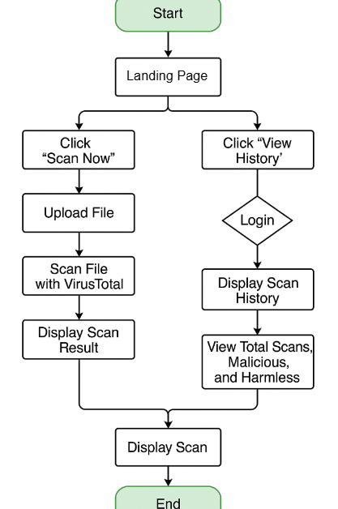
FLOW CHART:

Slide 7
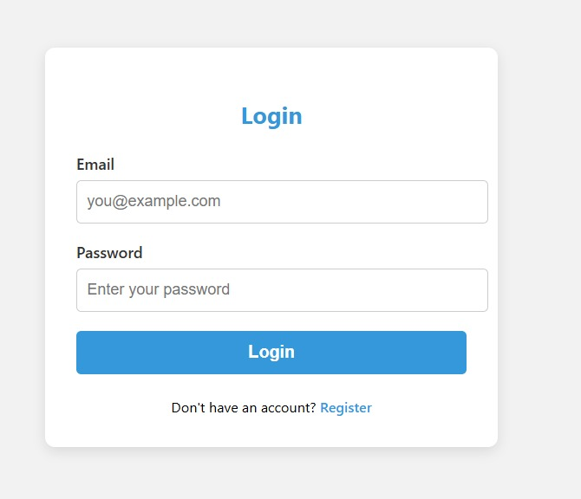
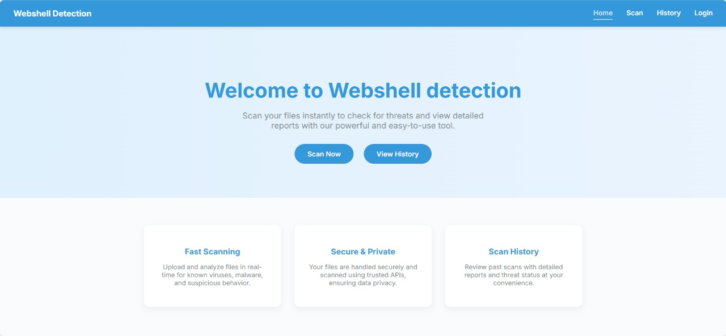
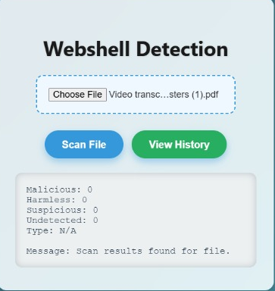
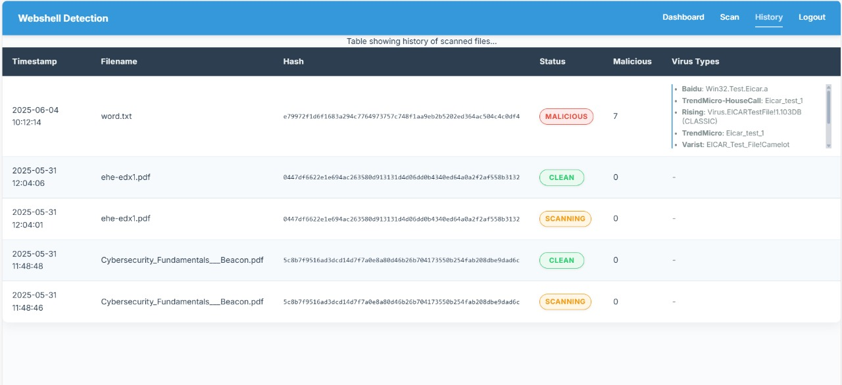
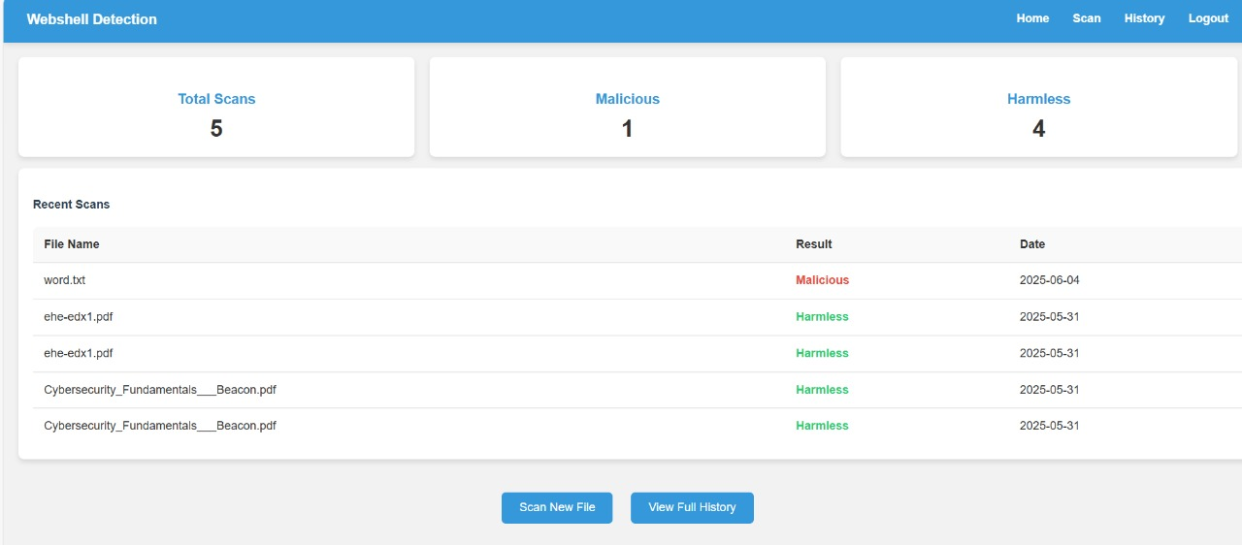
IMPLEMENTATION SCREENS

Slide 8
REFERENCES
ChatGpt:https://chatgpt.com/c/6846f085-7f2c-8003-96ca-7b6bf6ba354f
VirusTotalAPI:https://www.virustotal.com/gui/home/upload

Slide 9
CONCLUSION
In this project, we created a simple web application to scan and detect harmful files using the VirusTotal API. The user can upload a file and check if it is safe or not. We also added a feature to view the history of scanned files. The scan history shows the file name, scan time, result, and virus types. We added a login system to keep the history safe and only allow access to the right users.
This project helps users stay safe by checking files before using them. It is easy to use, and the results are fast and reliable. In the future, we can improve this project by adding more scanning tools, better design, and user alert

Slide 10
THANK YOU
09

